Slide 1
Adaptations

Slide 2
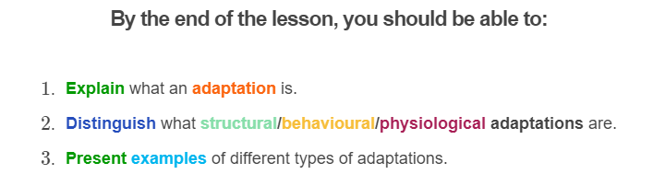
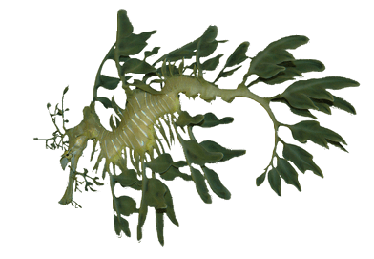

Slide 3
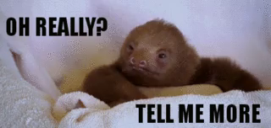
To survive, animals must adapt to their environment.
An adaptation is a way an animal's body helps it survive, or live, in its environment.
During this lesson, you will learn the different types of adaptations that are necessary for an organism's survival.

Slide 4
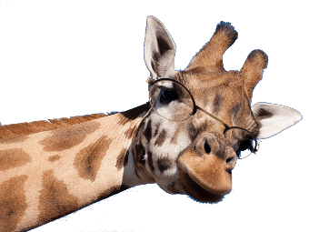
Ever wondered why giraffes have long necks?
The giraffe’s long neck is a perfect adaptation to help them reach high tree leaves to eat and to spot potential danger lurking, such as the lion!

Slide 5
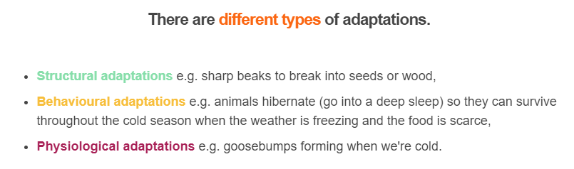
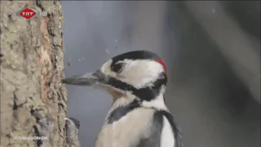
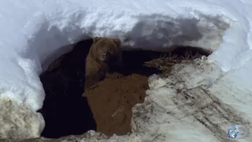

Slide 6
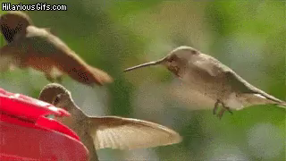
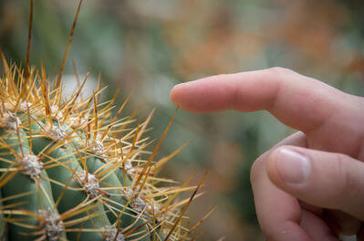
Structural adaptations are physical features of an organism that help it survive.
The beak on a bird is an example, but also the fur on a bear or thorns on a cactus. They all involve some physical part of the organism.

Slide 7
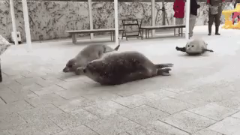
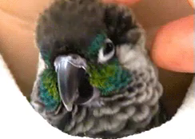
Insulation is one important structural feature used by mammals and birds for thermoregulation.
This is how they keep their bodies at a constant core temperature.
Hair, feathers or layers of fat under the skin can reduce the flow of heat between the animal and its environment, keeping the body nice and warm.

Slide 8
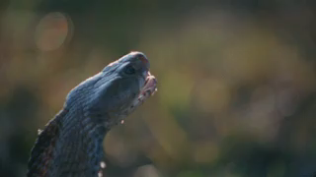
Physiological adaptations are another way in which organisms survive.
They allow an organism to perform special functions, like a snake's ability to inject venom.
Physiological adaptations also help with more general functions such as thermoregulation, growth, development and fighting infections.

Slide 9
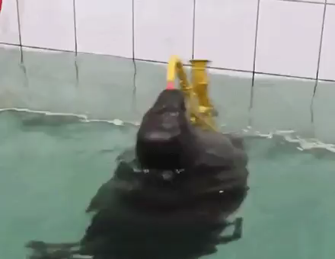
Here is an example of a physiological adaptation.
In seals and other marine mammals, the blood vessels near the surface of the body constrict when they're swimming in cold water.
This directs more blood to the body's core, keeping the important parts warm.

Slide 10
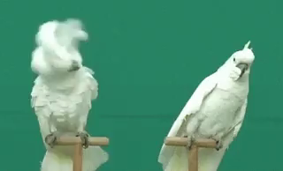
Behavioural adaptations are the actions organisms take to survive.
Bird calls and migration are examples of behavioral adaptations. These behaviours are not learned, like nose-picking in humans.
Birds are born with the instinctive knowledge of how to call out to their parents. They learn over time more calls to communicate with other birds.

Slide 11
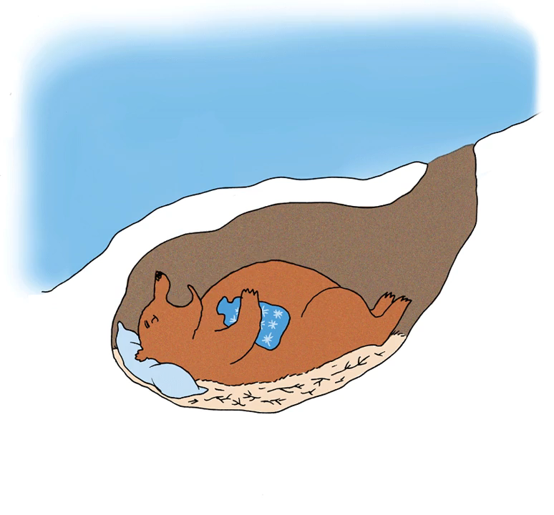
Hibernation is a behavioural adaptation of some animals.
This is a special, very deep sleep. The animal's body temperature drops and its heartbeat and breathing slow down.
It uses as little energy as possible.

Slide 12
